Slide 1
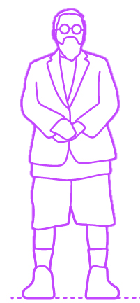
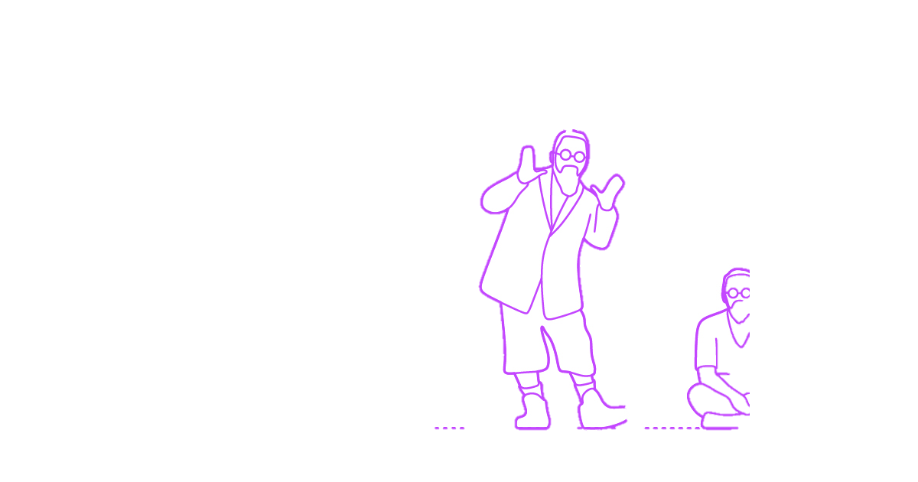
Swarm Intelligence with Graph Neural Networks

Slide 2
Overview
Task
Reward
MARL
Performance
Training
GNN

Slide 3

Task
Reward
MARL
Performance
Training
GNN
step on the platform
or
don‘t step on the platform
is occupied
or
is not occupied

Slide 4

Task
Reward
MARL
Performance
Training
GNN
step on the platform
or
don‘t step on the platform
is occupied
or
is not occupied

Slide 5
Task
Reward
MARL
Performance
Training
GNN
step on the platform
or
don‘t step on the platform
is occupied
or
is not occupied

Slide 6

Task
Reward
MARL
Performance
Training
GNN
step on the platform
or
don‘t step on the platform
is occupied
or
is not occupied

Slide 7
Task
Reward
MARL
Performance
Training
GNN
step on the platform
or
don‘t step on the platform
is occupied
or
is not occupied

Slide 8
Task
Reward
MARL
Performance
Training
GNN
step on
the platform
don‘t step on
the platform
is
occupied
is not
occupied

Slide 9

Task
Reward
MARL
Performance
Training
GNN
step on
the platform
don‘t step on
the platform
is
occupied
is not
occupied
score smart behaviour, not correct behaviour

Slide 10
Task
Reward
MARL
Performance
Training
GNN
step on
the platform
don‘t step on
the platform
is
occupied
+1
-1
is not
occupied
-1
0
score smart behaviour, not correct behaviour

Slide 11
Task
Reward
MARL
Performance
Training
GNN
step on
the platform
don‘t step on
the platform
is
occupied
+1
-1
is not
occupied
-1
+1

Slide 12
Task
Reward
MARL
Performance
Training
GNN
+
is never
occupied
pr[switch oracle] = 1
step on
the platform
don‘t step on
the platform
time
total score =
0

Slide 13
Task
Reward
MARL
Performance
Training
GNN
+
is never
occupied
pr[switch oracle] = 1
step on
the platform
+1
don‘t step on
the platform
time
total score =
+1

Slide 14
Task
Reward
MARL
Performance
Training
GNN
+
is never
occupied
pr[switch oracle] = 1
step on
the platform
-1
+1
don‘t step on
the platform
time
total score =
0

Slide 15
Task
Reward
MARL
Performance
Training
GNN
+
is never
occupied
pr[switch oracle] = 1
step on
the platform
-1
+1
+1
don‘t step on
the platform
time
total score =
+1

Slide 16
Task
Reward
MARL
Performance
Training
GNN
+
is never
occupied
pr[switch oracle] = 1
step on
the platform
-1
-1
+1
+1
don‘t step on
the platform
time
total score =
0

Slide 17
Task
Reward
MARL
Performance
Training
GNN
+
is never
occupied
pr[switch oracle] = 1
step on
the platform
-1
-1
don‘t step on
the platform
0
0
time
score smart behaviour, not correct behaviour
total score =
-2
Notes:
Score really represents if the agents step on the platform if asked to

Slide 18
Task
Reward
MARL
Performance
Training
GNN
step on
the platform
don‘t step on
the platform
is
occupied
+1
-1
is not
occupied
-1
0
score smart behaviour, not correct behaviour

Slide 19
Task
Reward
MARL
Performance
Training
GNN
step on the platform
or
don‘t step on the platform
is occupied
or
is not occupied

Slide 20
Task
Reward
MARL
Performance
Training
GNN
step on the platform
or
don‘t step on the platform
is occupied
visibility range
or
is not occupied

Slide 21
Task
Reward
MARL
Performance
Training
GNN
step on the platform
or
don‘t step on the platform

Slide 22
Task
Reward
MARL
Performance
Training
GNN
step on the platform
or
don‘t step on the platform

Slide 23
Task
Reward
MARL
Performance
Training
GNN
step on the platform
or
don‘t step on the platform

Slide 24
Task
Reward
MARL
Performance
Training
GNN
step on the platform
or
don‘t step on the platform

Slide 25
Task
Reward
MARL
Performance
Training
GNN
6 timesteps + uncertainty about change
?

Slide 26
Task
Reward
MARL
Performance
Training
GNN
6 timesteps + uncertainty about change

Slide 27
Task
Reward
MARL
Performance
Training
GNN
6 timesteps + uncertainty about change

Slide 28
Task
Reward
MARL
Performance
Training
GNN
6 timesteps + uncertainty about change
step on the platform
or
don‘t step on the platform

Slide 29
Task
Reward
MARL
Performance
Training
GNN
6 timesteps + uncertainty about change
step on the platform
or
don‘t step on the platform
4 timesteps + communication line
floor(distance / visibility range) + 1

Slide 30
Task
Reward
MARL
Performance
Training
GNN
Performance = achieved score / max score
2) wait for information travel (floor(distance / visibility range) + 1 timesteps)
change oracle output with pr=0.05
3) reward

Slide 31
Task
Reward
MARL
Performance
Training
GNN

Slide 32
Task
Reward
MARL
Performance
Training
GNN

Slide 33
Task
Reward
MARL
Performance
Training
GNN

Slide 34
Task
Reward
MARL
Performance
Training
GNN

Slide 35
Task
Reward
MARL
Performance
Training
GNN

Slide 36
Task
Reward
MARL
Performance
Training
GNN
relative location to:
- oracle
- platform
trace
communication vector
…
distance
importance
…

Slide 37
Why GNN‘s?
Task
Reward
MARL
Performance
Training
GNN
Permutation invariance
Scalability
Central Critic (Graph Classification) with Distributed Execution
Also:
Leverage PyG

Slide 38
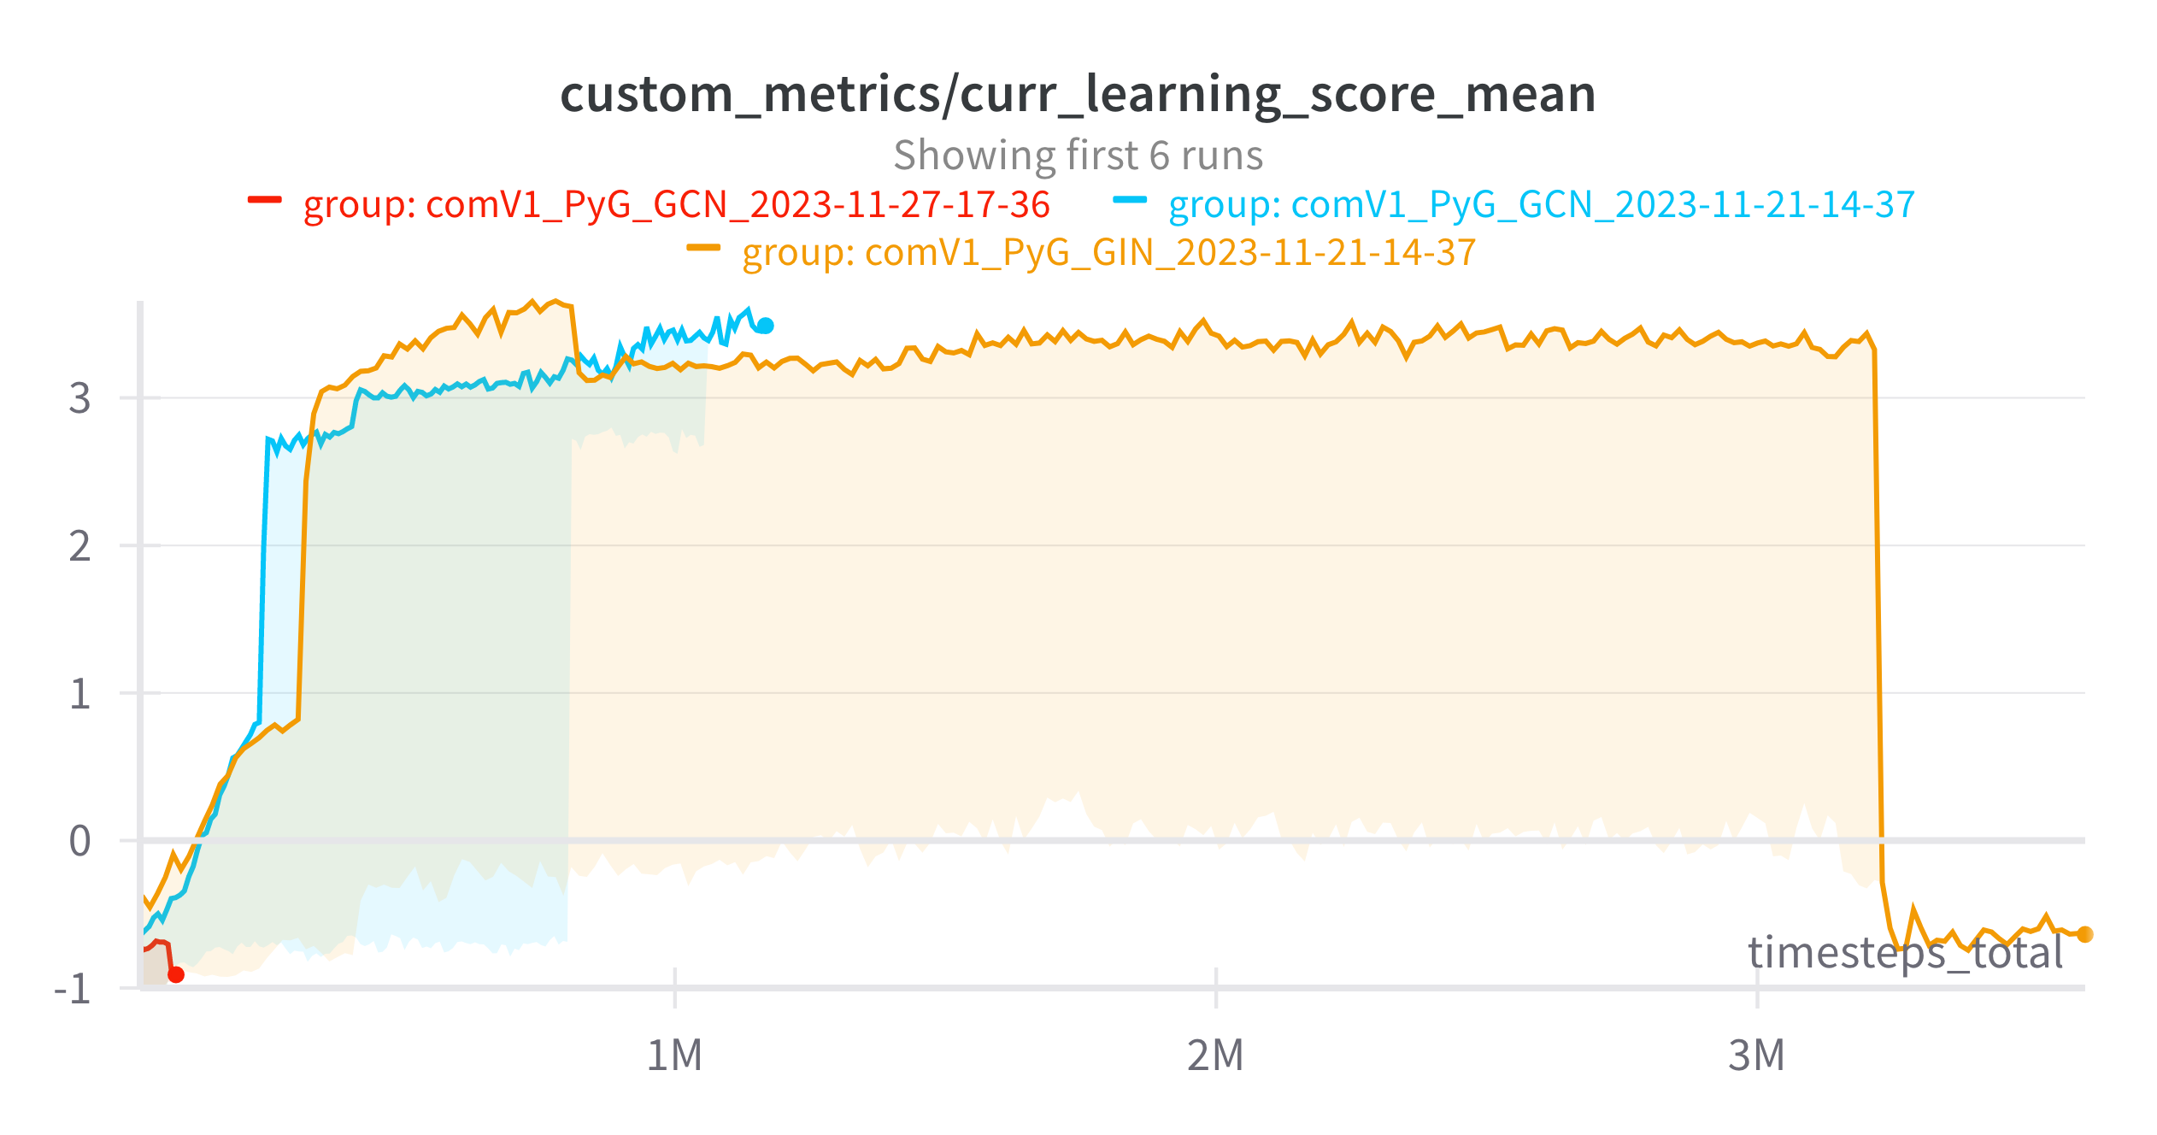
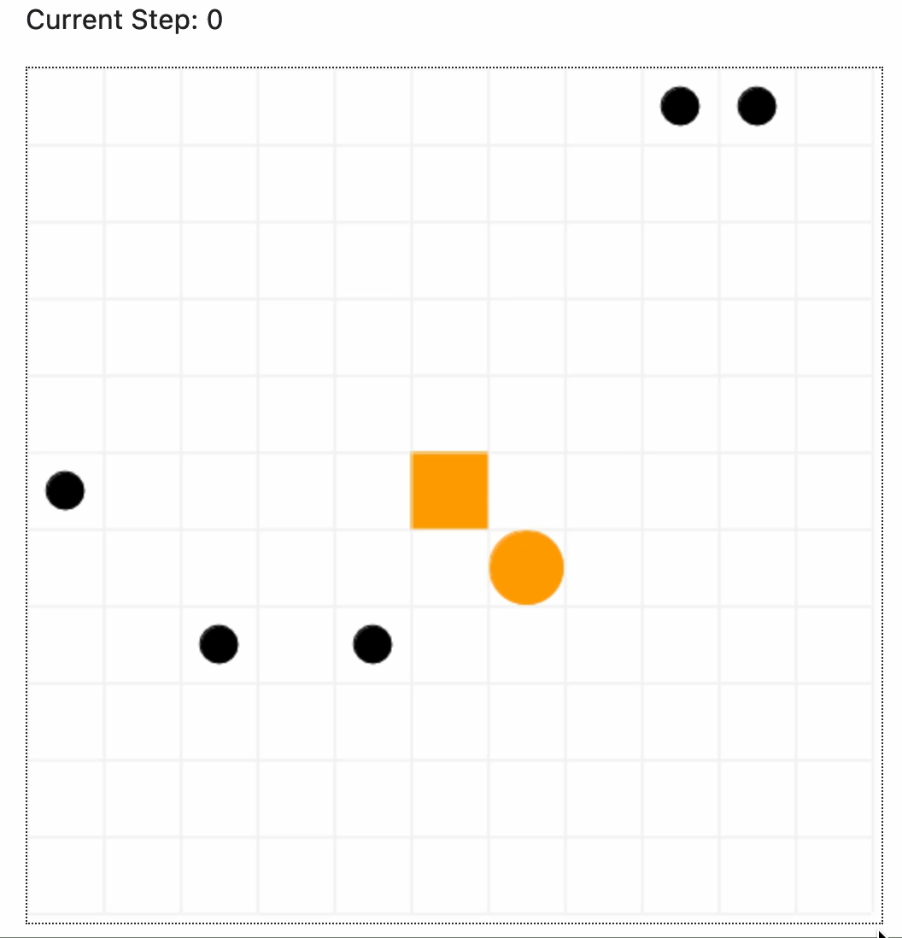
Preliminary Results
Overfitting on location
Productive Architecture
PyG integration

Slide 39




Current Architecture
ARTON
train.py
run
environment
model
configs/
tunables

Slide 40
Current Architecture
environment
abm
ARTON
train.py
boilerplate rl
run
environment
model
configs/
tunables

Slide 41
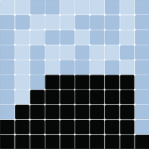
Current Architecture
MESA
agent-based model
grid
environment
abm
worker
ARTON
train.py
boilerplate rl
oracle
run
environment
model
platform
configs/
tunables

Slide 42

Current Architecture
MESA
agent-based model
grid
environment
abm
worker
ARTON
train.py
boilerplate rl
oracle
run
environment
model
platform
configs/
tunables
torch module
actor
critic

Slide 43
Current Architecture
MESA
agent-based model
grid
environment
abm
worker
ARTON
train.py
boilerplate rl
oracle
run
environment
model
platform
configs/
tunables
torch module
actor
model
- model type
- hidden layers
- layer sizes
env
- num agents
- grid size
- visibility range
tuner
- batch size
- num timesteps
critic

Slide 44
Current Architecture
MESA
single agent RL abstraction
agent-based model
grid
environment
get graph info
- node values
- edges
abm
worker
ARTON
train.py
boilerplate rl
oracle
run
environment
model
platform
configs/
tunables
torch module
actor
model
- model type
- hidden layers
- layer sizes
env
- num agents
- grid size
- visibility range
tuner
- batch size
- num timesteps
critic

Slide 45
Outlook
Decouple Tasks
Movement
Communication
Find Node/ Edge information that solves the task
Benchmark model with other tasks
Notes:
Lernen kommunizieren ohne das wir sagen was sie machen sollen
Sparser reward ist bewusst
wir wollen das actions gelernt werden
wenns bei diesem task klappt, können wirs auch für andere tasks laufen lassen, ohne veränderung. hat gezeigt, dass es funktioniert
andere tasks als outlook. benchmark mit anderen modellen
short term goals, long term goals

Slide 46
Discussion
Notes:
start with fully connected graph, then boil it down
fungus
curriculum: single agent, then add agents and increase (stronger punish)
switching more the platform and oracle
unklar:
- graph als grid
- graph und plattform als knoten, mit encoding
sine_cosie embedding auf edges
platform nicht zu fest verschieben, nur um 1-2
anstatt grid, winkel und distanz
oracle platform wird weggeschmissen

Slide 47
Current Architecture
MESA
agent-based model
grid
environment
abm
worker
get observation
boilerplate rl
oracle
platform
torch module
actor
critic

Slide 48
Current Architecture
MESA
agent-based model
grid
environment
get graph info
- node values
- edges
abm
worker
get observation
boilerplate rl
oracle
platform
torch module
actor
critic

Slide 49
Current Architecture
MESA
agent-based model
grid
environment
get graph info
- node values
- edges
abm
worker
get observation
boilerplate rl
oracle
linearize
obs
platform
torch module
actor
critic

Slide 50
Current Architecture
MESA
agent-based model
grid
environment
get graph info
- node values
- edges
abm
worker
get observation
boilerplate rl
oracle
linearize
obs
platform
re-build graph
torch module
actor
critic

Slide 51
Current Architecture
MESA
agent-based model
grid
environment
get graph info
- node values
- edges
abm
worker
get observation
boilerplate rl
oracle
linearize
obs
platform
re-build graph
action
torch module
linearize
actor
critic

